Slide 1
Wikidata.lib

Slide 2
Agenda
Introduction to Wikidata
Wikidata Prozess
Generelle Aufgabe: Was ist Wikidata? Wikidata verbessern(Aufgaben)
Demo - vorher/nachher
Verfahren
- leere Objekte, volle Objekte, klassifizierer
Datenerfassung, vorberechnung
Suggestion berechnung mit mysql
Rapidprototyping/Entwicklungsprozess

Slide 3
Wikidata
What is Wikidata?
What is its purpose?

Slide 4
Improve it(Liste v Aufgaben)
List of initial tasks

Slide 5
Projects
PubSubHubub
Property Suggester

Slide 6
Meta meta meta
Gerrit, Labs, Accounts, waiting time, review process, architecture…
Mailing List (active community)

Slide 7
Demo
Notes:
Auf UI hinweisen, im Vergleich zum alten

Slide 8
Property Process
How did we implement it?
Rapid Prototyping
Weekly hangouts (+ personal meetings) → instant review→ incremental improvement
3 wikidata contacts: Lydia (Product Manager), Daniel (Developer) and Abraham (Project Manager)

Slide 9
Mögliche Vorschlagstypen
Existing Item with list of preexisting properties
Empty Item (new Item) – task : find frequently used classifiers
More detailed suggestions (values, qualifier etc.)
Suggest misfits
Future plans

Slide 10
Workflow
XML/JSON Dump
Feature CSV
PHP Suggester
Suggestions
Dump parser
MySQL Table
Calculate Correlations

Slide 11
Workflow
XML/JSON Dump
Feature CSV
PHP Suggester
Suggestions
Dump parser
MySQL Table
Calculate Correlations
XML Dump (25GB)
Contains all Wikidata pages and JSON data in the <text> tag
Convert to CSV
Python
XML Stream Parser (xml.etree.cElementTree)
JSON Parser (ujson)
30minutes
CSV (1.7GB)
Q1,31,wikibase-entityid,Q223557
Entity: Q1 (Universe)
Property: 31 (instance of)
Property Type: wikibase-entityid
Value: Q223557 (Physical Object)

Slide 12
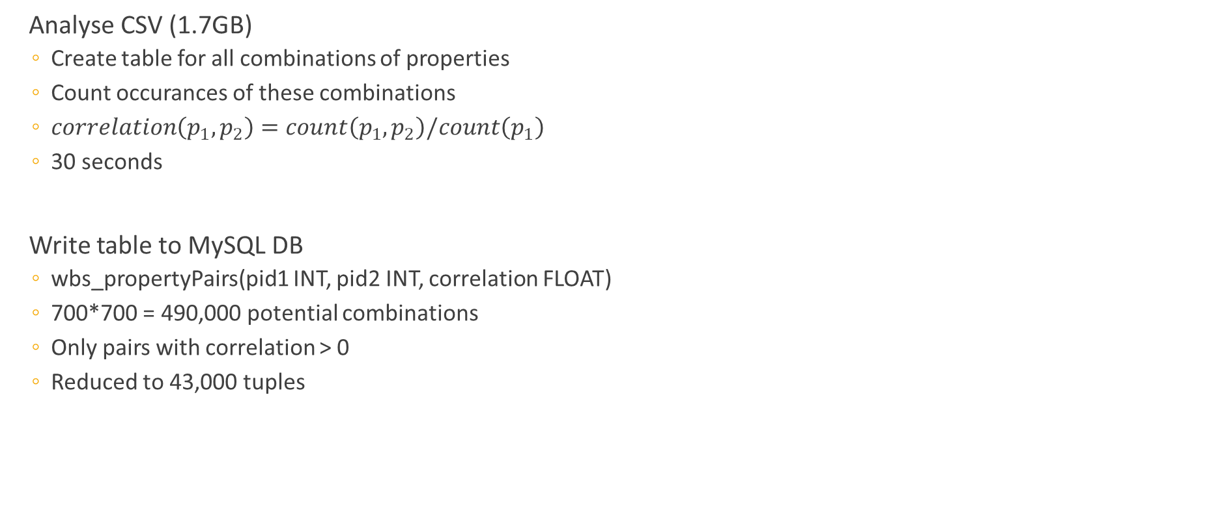
Workflow
XML/JSON Dump
Feature CSV
PHP Suggester
Suggestions
Dump parser
MySQL Table
Calculate Correlations
Analyse CSV (1.7GB)
Create table for all combinations of properties
Count occurances of these combinations
$correlation\left(p_{1},p_{2}\right)=count\left(p_{1},p_{2}\right)/count\left(p_{1}\right)$
30 seconds
Write table to MySQL DB
wbs_propertyPairs(pid1 INT, pid2 INT, correlation FLOAT)
700*700 = 490,000 potential combinations
Only pairs with correlation > 0
Reduced to 43,000 tuples

Slide 13
Workflow
XML/JSON Dump
Feature CSV
PHP Suggester
Suggestions
Dump parser
MySQL Table
Calculate Correlations
MySQL Table
wbs_propertyPairs(pid1 INT, pid2 INT, correlation FLOAT)
Provide Suggestions
Input: Entity E
with a list of properties $L
$size = count($L)
SELECT pid2, sum(correlation)/$size AS cor FROM wbs_PropertyPairs WHERE pid1 IN $L AND pid2 NOT IN $L GROUP BY pid2 HAVING sum(correlation)/$size > $threshold ORDER BY cor DESC LIMIT $limit

Slide 14
Future plans
Find classifier – generate tables so that classifier value combinations can be suggested/used for Suggestions
Find „misfit“ – use suggestion-engine
Implement strategies to modify the rating of certain properties
- usecase: decrement rank for identifiers (possible approaches)
- usecase: user feedback regarding suggestions (ui challenges)
Other challenges / ideas?!
- get example values from items that are similiar to the one currently being edited (use classifier)

Slide 15
Classifiers
Why classifiers?
Items belonging to the same class often have similiar sets of properties
Classifier-Value-Pairs are very useful for finding appropriate suggestions
Great suggestions for items without preexisting properties
Ideas on identifying useful/good classifiers:
They are frequently used (as every item should probably belong to at least one class)
Their values are items (since classes will/should be represented by an item in wikidata)
Items in the same class should have more in common then those that are not
Notes:
Classifiers = attribut that connect an item to a class

Slide 16
Algorithm for finding classifiers
Only consider properties with datatype:item
Find the 10 most frequently used properties
Rate every property p as follows:
Suggestions = []
Find the 10 most frequent values for p (most common classes)
For every class do:
If a property appears in more than 50% of the class members: Suggestions.add(property)
If a property in Suggestions is used for over 30% of all items described by p: Suggestions.remove(property)
Rating = len(Suggestions)
Compare the potential classifiers according to their rating
Satisfying results when used on the current dump -> Top rating classifiers: instanceOf & occupation
Notes:
Algorithm for generating suggestions based on classifiers IS very similiar to our general approach:
->Now one extra table for each classifier with one row for each classifier-value-combination
Percentage thresholds and number of properties/classes can/could be adjusted
Examples during explanation: sex vs instanceOf

Slide 17
Adjust property raking
Motivated by possible use cases:
Use Case 1: downgrade rank of identifiers (moslty filled in by bots)
Use Case 2: taking user feedback into consideration
Strategy
Have an extra column “increment/decrement value“ in table properties
Update this column by analysing wikidata dumps, user feedback etc.
Join “propertyValuePairs“ with “properties“ during ranking process and make adjustments

Slide 18
Finding “Misifits“
Todo

Slide 19
Finding examples/representatives
Todo

